Slide 1
Cluster Algorithms and Results
By Kevin Yean

Slide 2
Algorithms and Data Set Used
Single Linkage
Complete Linkage
Average Linkage
Lloyd’s Method /K-Mean
DBSCAN
Hamming Distance Algorithm
Iris Data Set
Knowledge Data Set
Seed Data Set

Slide 3
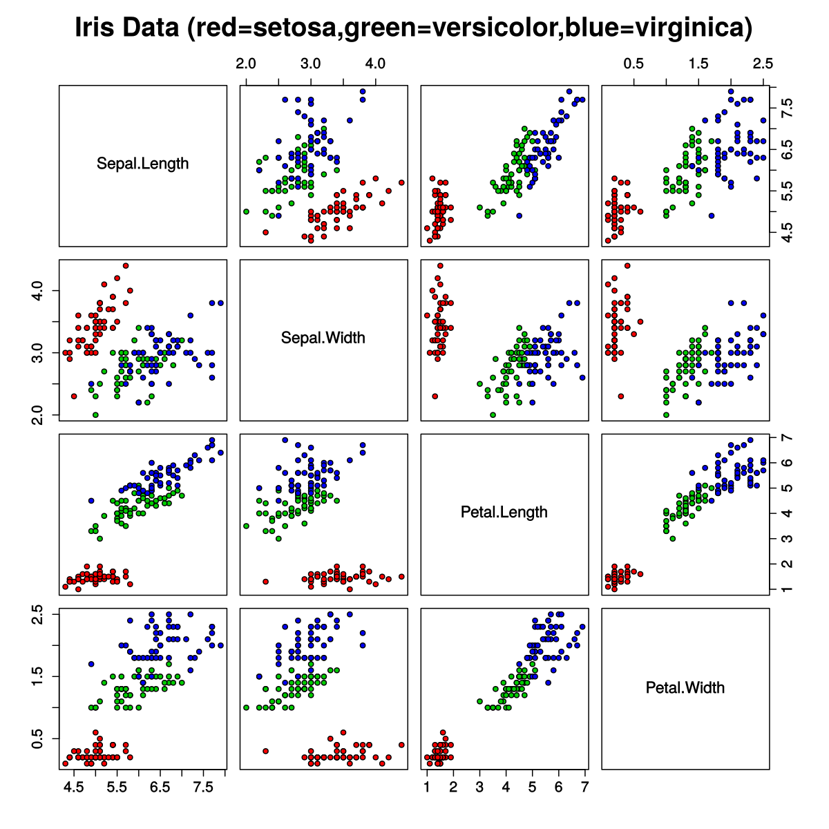
Iris Data Set
Setosa: ⬛, Versicolor: ⬛, Virginica:⬛
Number of Instances: 150
Number of Attributes: 4
Sepal Length in cm.
Sepal Width in cm.
Petal Length in cm.
Petal Width in cm.
Number of Labels: 3
Iris Setosa (50 instances)
Iris Versicolor (50 Instances)
Iris Virginica (50 Instances)
Graphs created by Nicoguaro

Slide 4
Iris Data Set Result, 1 of 2
Single Linkage: Hamming Dist. = 0.2236
Complete Linkage: Hamming Dist. = 0.1632
Clusters | Iris Setosa | Versicolor | Virginica
1 | 50 | 0 | 0
2 | 0 | 50 | 48
3 | 0 | 0 | 2
Clusters | Iris Setosa | Versicolor | Virginica
1 | 50 | 0 | 0
2 | 0 | 23 | 49
3 | 0 | 27 | 1
Average Linkage: Hamming Dist. = 0.1077
Lloyd's Method: Hamming Dist. = 0.1202
Clusters | Iris Setosa | Versicolor | Virginica
1 | 50 | 0 | 0
2 | 0 | 50 | 14
3 | 0 | 0 | 36
Clusters | Iris Setosa | Versicolor | Virginica
1 | 26 | 3 | 0
2 | 24 | 0 | 0
3 | 0 | 47 | 50

Slide 5
Iris Data Set Result, 2 of 2
DBScan (0.39f, 3) : Hamming Dist. = 0.1177 (With Outliers) / 0.0490 (No Outliers)
Clusters | Iris Setosa | Versicolor | Virginica
1 | 47 | 0 | 0
2 | 0 | 38 | 0
3 | 0 | 3 | 32
4 | 0 | 4 | 0
Outliers | 3 | 5 | 18
Algorithms: | Single Linkage | Complete Linkage | Average Linkage | Lloyd’s Method | DBScan Algorithm
Hamming Dist. : | 0.2234 | 0.1632 | 0.1077 | 0.1202 | 0.1177 | 0.0490

Slide 6
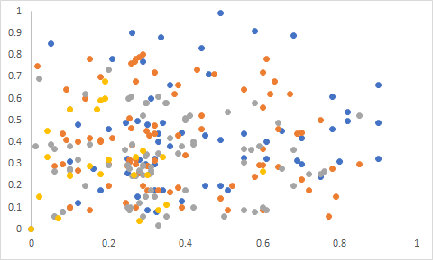
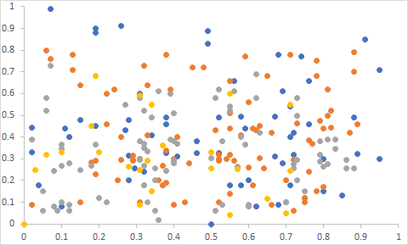
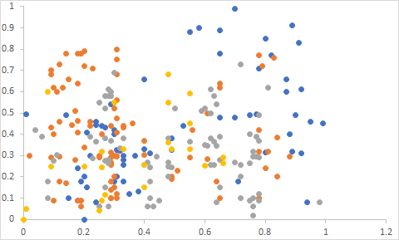
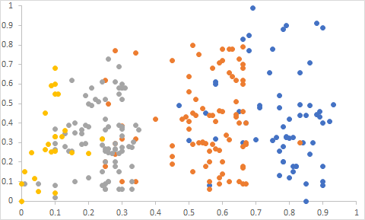
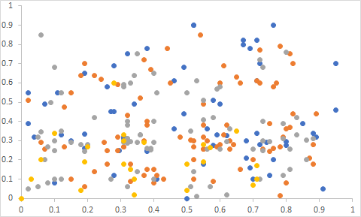
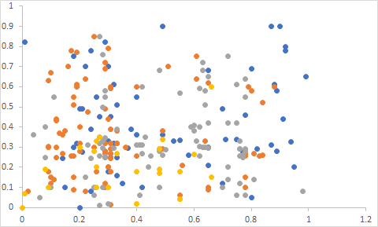
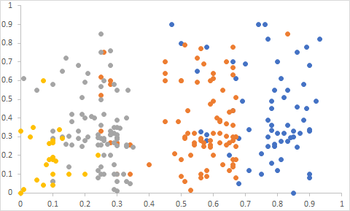
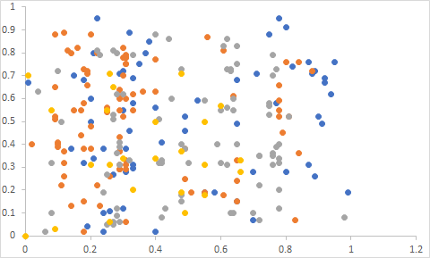
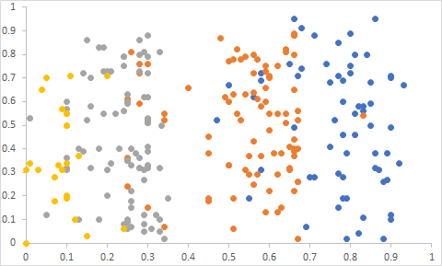
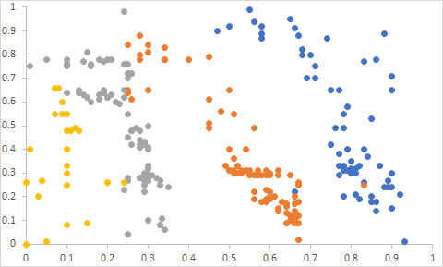
Knowledge Data Set
High: ⬛, Middle: ⬛, Low:⬛ , Very Low:⬛
Degree of Study for Main Subject
Number of Instances: 258
Number of Attributes: 5
The degree of study time for main subject.
The degree of repetition number for main subject.
The degree of study time for related subjects.
Exam Performance for related subjects.
Exam Performance for main subject.
Number of Labels: 4
Very Low (24)
Low(83)
Middle(88)
High(63)
Degree of Repetition number for Main subject
The Degree of Study time for related subjects
Exam Performance for related subjects
Exam Performance for Main subject

Slide 7
Knowledge Data Set Result, 1 of 3
Single Linkage: Hamming Dist. = 0.6915
Complete Linkage: Hamming Dist. = 0.3432
Clusters | Very Low | Low | Middle | High
1 | 24 | 82 | 88 | 58
2 | 0 | 0 | 0 | 3
3 | 0 | 1 | 0 | 0
4 | 0 | 0 | 0 | 1
Clusters | Very Low | Low | Middle | High
1 | 12 | 7 | 0 | 0
2 | 3 | 20 | 65 | 37
3 | 0 | 55 | 20 | 2
4 | 0 | 1 | 3 | 22

Slide 8
Knowledge Data Set Result, 2 of 3
Average Linkage: Hamming Dist. = 0.3413
Lloyd’s/K-Mean: Hamming Dist. = 0.3231
Clusters | Very Low | Low | Middle | High
1 | 1 | 0 | 0 | 0
2 | 6 | 17 | 64 | 34
3 | 17 | 66 | 21 | 0
4 | 0 | 0 | 3 | 29
Clusters | Very Low | Low | Middle | High
1 | 0 | 11 | 42 | 21
2 | 21 | 54 | 13 | 1
3 | 3 | 18 | 29 | 16
4 | 0 | 0 | 4 | 25

Slide 9
Knowledge Data Set Result, 3 of 3
DBScan (0.255f, 10) : Hamming Dist. = 0.1667 (With Outliers) / 0.2660 (No Outliers)
Clusters | Very Low | Low | Middle | High
1 | 0 | 2 | 37 | 10
2 | 0 | 0 | 3 | 8
3 | 6 | 20 | 1 | 0
4 | 0 | 8 | 4 | 0
Outliers | 16 | 53 | 43 | 45
Algorithms: | Single Linkage | Complete Linkage | Average Linkage | LLoyd’s / K-mean | DBScan Method
Hamming Dist. : | 0.6915 | 0.3432 | 0.3413 | 0.3231 | 0.1667|0.2660

Slide 10
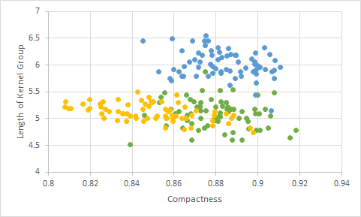
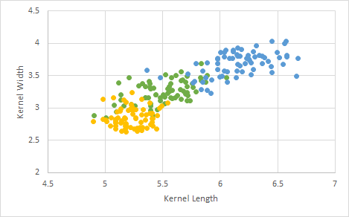
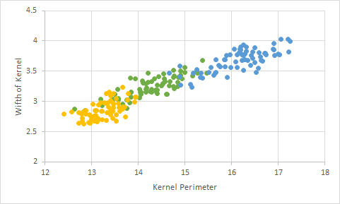
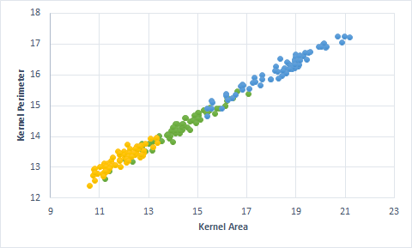
Wheat Seed Data Set
Kama: ⬛, Rosa:⬛,Canadian: ⬛
Number of Instances: 210
Number of Attributes: 7
Kernel Area
Kernel Perimeter
Compactness
Length of Kernel
Width of Kernel
Asymmetry Coefficient
Length of Kernel Group
Labels: 3
Kama Kernel (70) (Labelled as 1)
Rosa Kernel (70) (Labelled as 2)
Canadian Kernel(70) (Labelled as 3)

Slide 11
Wheat Data Set Result, 1 of 2
Single Linkage: Hamming Dist. = 0.6431
Complete Linkage: Hamming Dist. = 0.2038
Clusters | Kama | Rosa | Canadian
1 | 70 | 64 | 68
2 | 0 | 6 | 0
3 | 0 | 0 | 2
Clusters | Kama | Rosa | Canadian
1 | 52 | 23 | 0
2 | 18 | 0 | 70
3 | 0 | 47 | 0
Average Linkage: Hamming Dist. = 0.1135
Lloyd's Method/K-Mean: Hamming Dist. = 0.1256
Clusters | Kama | Rosa | Canadian
1 | 66 | 6 | 9
2 | 3 | 0 | 61
3 | 1 | 64 | 0
Clusters | Kama | Rosa | Canadian
1 | 9 | 0 | 68
2 | 60 | 10 | 2
3 | 1 | 60 | 0

Slide 12
Wheat Data Set Result, 2 of 2
DBScan (0.9f, 3) : Hm. Dist. = 0.2842 (With Outliers) / 0.0490 (No Outliers)
Clusters | Kama | Rosa | Canadian
1 | 64 | 4 | 66
2 | 2 | 2 | 0
3 | 0 | 52 | 0
4 | 0 | 5 | 0
Outliers | 4 | 7 | 4
DBScan (0.9f, 10) : Hm. Dist. = 0.1663 (With Outliers) / 0.073 (No Outliers)
Clusters | Kama | Rosa | Canadian
1 | 47 | 2 | 0
2 | 7 | 0 | 58
3 | 0 | 37 | 0
Outliers | 16 | 31 | 12
Algorithms: | Single Linkage | Complete Linkage | Average Linkage | LLoyd’s Method | DBScan Method
Hamming Dist. : | 0.6431 | 0.2038 | 0.1135 | 0.1256 | 0.2842| 0.0490 0.1663|0.0743

